Slide 1
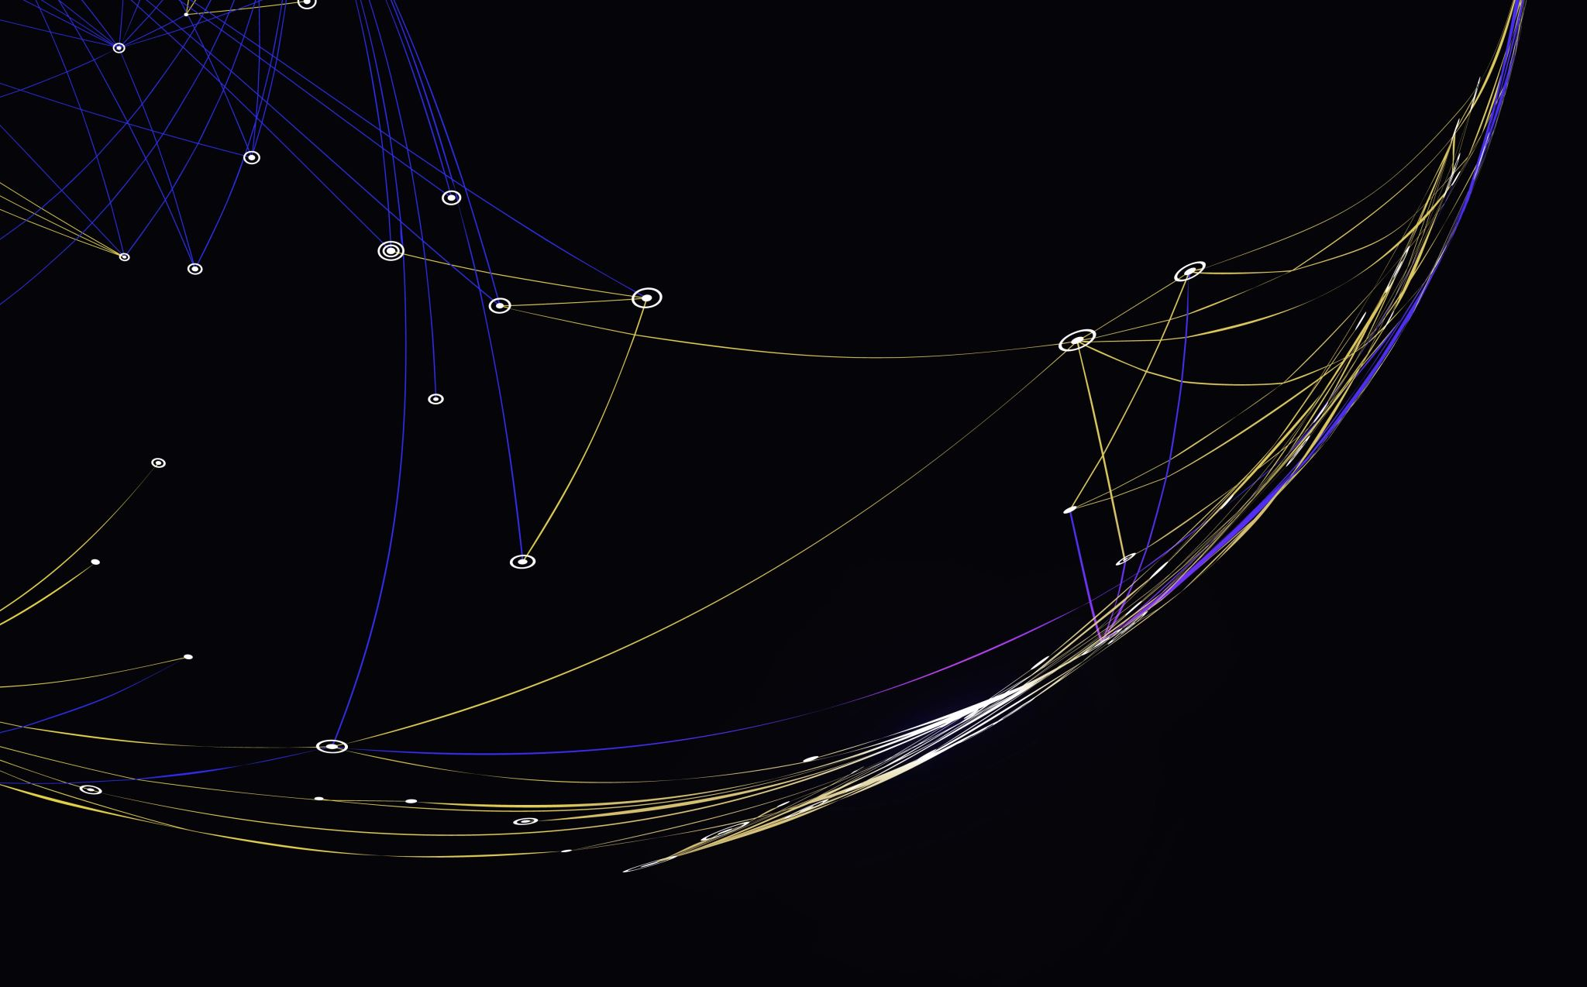
Improving Generalization of PV Panel Segmentation from Aerial Images across Using Conditional Generative Adversarial Networks
Kshitiz Khanal, Nikhil Kaza, Noah Kittner
Department of City and Regional Planning
University of North Carolina at Chapel Hill

Slide 2
Motivation
Deep Learning based computer vision models do not generalize well across images different from training images (e.g. images from different geographies in satellite images)
There’s a scarcity of training images and labels in some geographies, especially in developing countries
Models that generalize better across geographies would be useful in extracting energy infrastructure information from widely available aerial images for energy planning applications such as energy access, creating large scale energy infrastructure records/maps

Slide 3
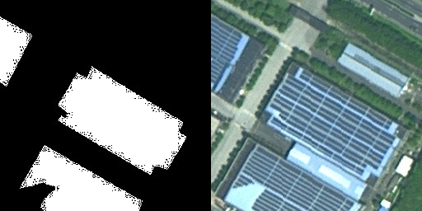

Slide 4
Conditional Generative Adversarial Networks (CGANs) have shown some promise in having better generalization across out of sample images in domains such as physics, medical image, land cover analyses.

Slide 5
We are testing if CGAN based energy infrastructure information extraction models can generalize better across geographies and resolutions than comparable deep learning models

Slide 6
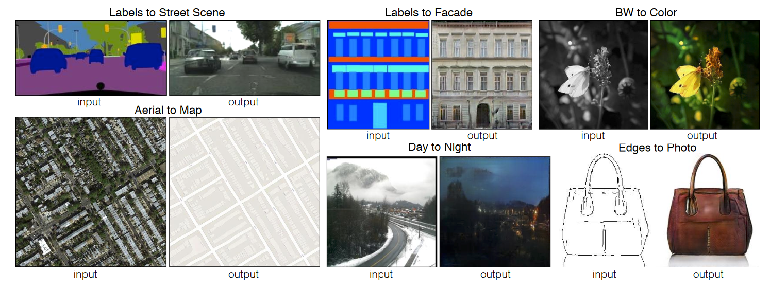
(Isola et al. 2017)

Slide 8
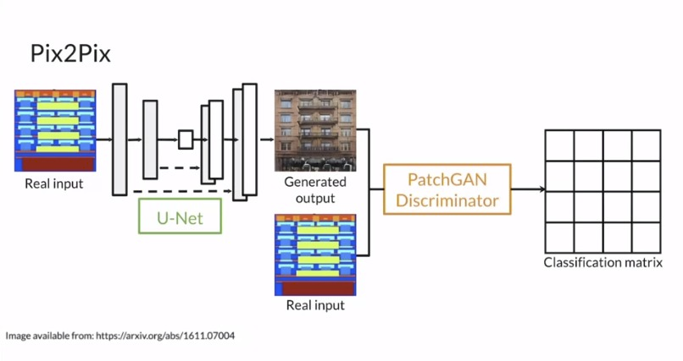
(Isola et al. 2017)

Slide 9
Pix2Pix (CGAN) vs UNET

Slide 10
Testing
Across terrains
Across resolutions
One combined dataset across separate terrains and resolutions

Slide 11
Terrains
Shrub
Saline-Alkali
Rooftop
Crop
Grass
Water

Slide 12
Setup
Shrub, SalineAlkali, Rooftop
1000 training images for each setup
50 test images for each combination
200 epoch of training for each

Slide 13
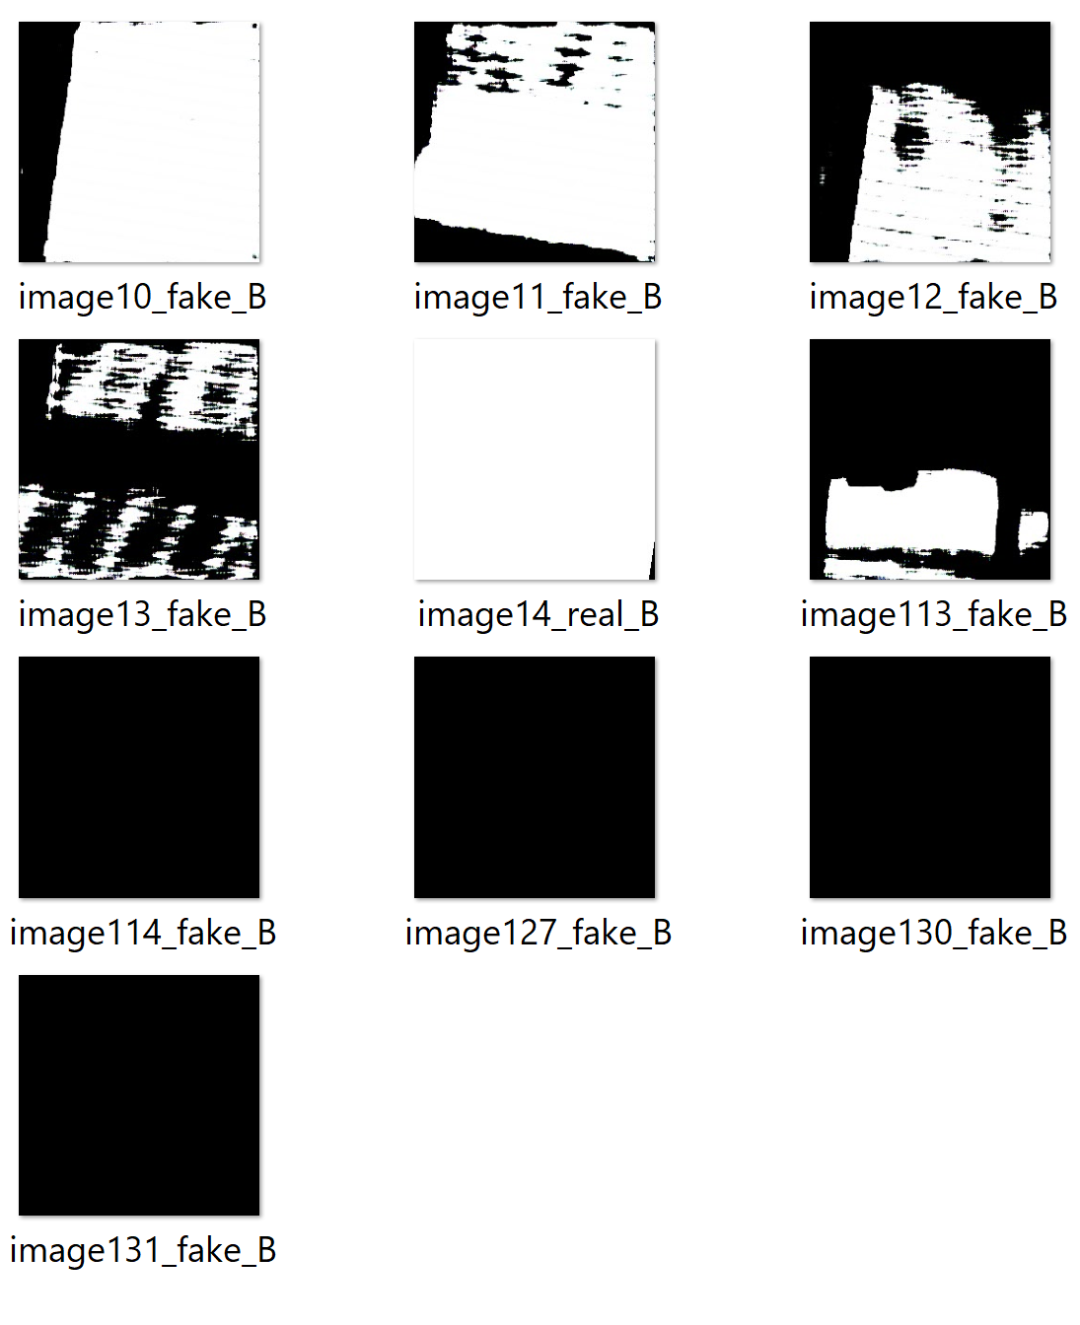
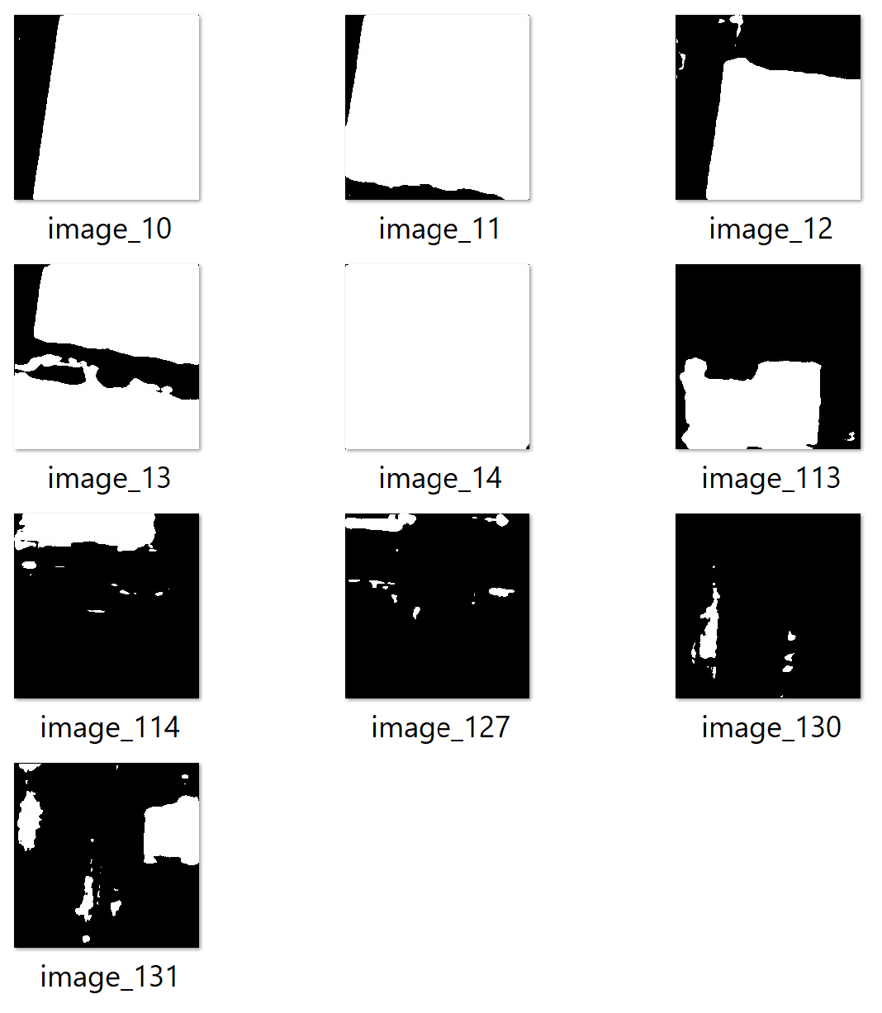
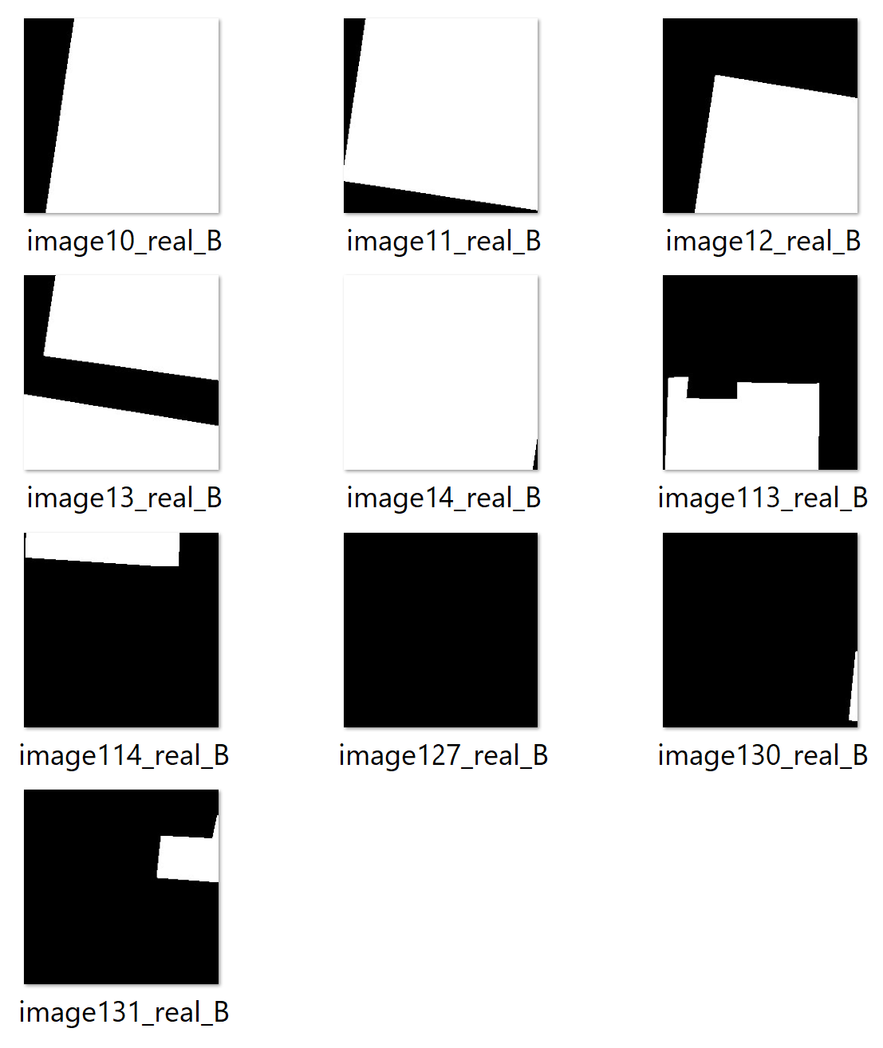
Pix2Pix
UNET
Target

Slide 14
Analysis
Roof to roof comparison on test data
Pix2Pix: 0.72
UNET: 0.91
Pix2Pix was undertrained compared to UNET

Slide 15
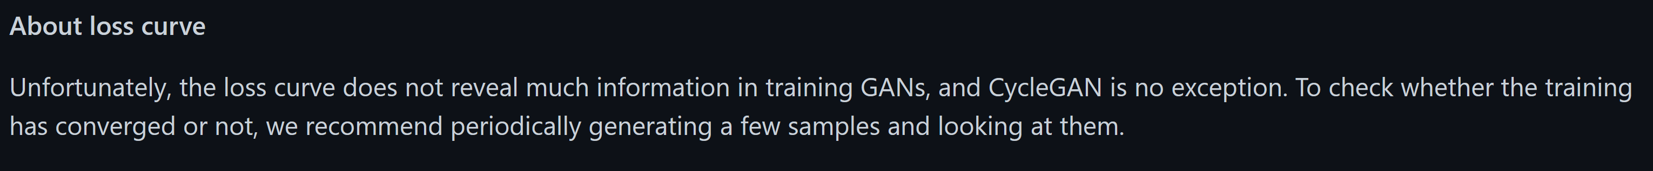
https://github.com/junyanz/pytorch-CycleGAN-and-pix2pix/blob/master/docs/tips.md

Slide 16
Visual observations
Both models perform decently when tested on similar terrain
Pix2Pix still generalizes better than UNET in a lot of cross-terrain cases but noting can be said definitively as UNET also does better in many cases
Applications need a lot of data and machine learning engineering such as polygonization, layer wise pretraining, fine tuning, etc.
Performance of Pix2Pix differs with different semantic composition, suggesting need of explainable deep learning to help explain when and how performance differs

Slide 17
Progress so far
Finished all data preparations for 6 different terrains and three resolutions
Model development is mostly done but needs tuning for comparability
Finished coding most of the pipeline for data input, output, and comparison
Started writeup and framing research for manuscript draft

Slide 18
Next
Retraining Pix2Pix to performance similar to UNET on test data for same terrain testing
Cross-terrain testing with more training data and better tuned models
Cross resolution testing
Explore if more suitable and diverse datasets are available
Exploring future research directions and applications

Slide 19
References
Jiang, Hou, Ling Yao, Ning Lu, Jun Qin, Tang Liu, Yujun Liu, and Chenghu Zhou. 2021. “Multi-Resolution Dataset for Photovoltaic Panel Segmentation from Satellite and Aerial Imagery.” Earth System Science Data 13 (11): 5389–5401.
Isola, Phillip, Jun-Yan Zhu, Tinghui Zhou, and Alexei A Efros. 2017. “Image-to-Image Translation with Conditional Adversarial Networks.” In Proceedings of the IEEE Conference on Computer Vision and Pattern Recognition, 1125–34.

Slide 20
Acknowledgment
Support for this work was provided by the Alfred P. Sloan Foundation through the Duke University Energy Data Analytics Fellowship program under Grant No. G-2020-13922. Conclusions reached or positions taken are of the researchers themselves and not those of the Alfred P. Sloan Foundation or its trustees, officers, or staff.

